Slide 1
Learn you some Erlang
UvA Summer School
Amsterdam
Arjan Scherpenisse
5 juli 2013
arjan@miraclethings.nl

Slide 2
Agenda
Intro
Language essentials
Concurrency / failure
OTP
Hands-on!

Slide 3
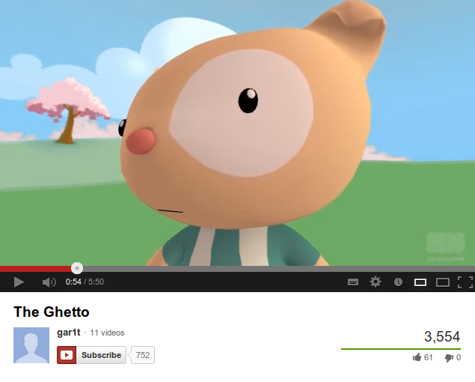

Slide 4
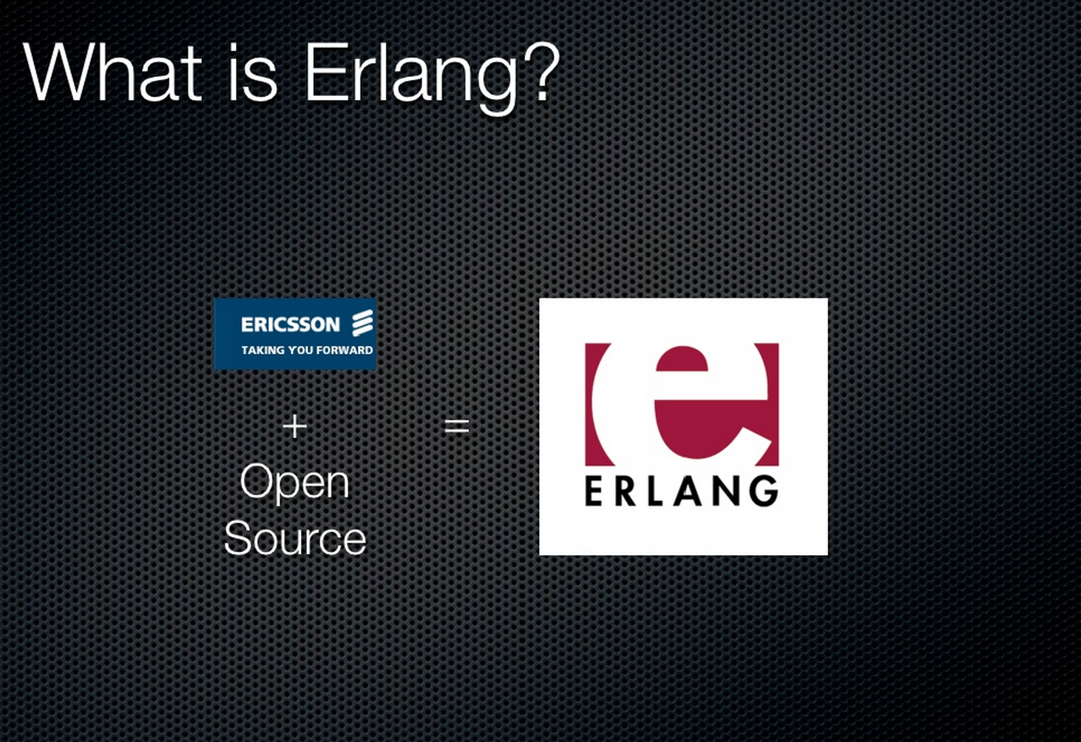

Slide 5
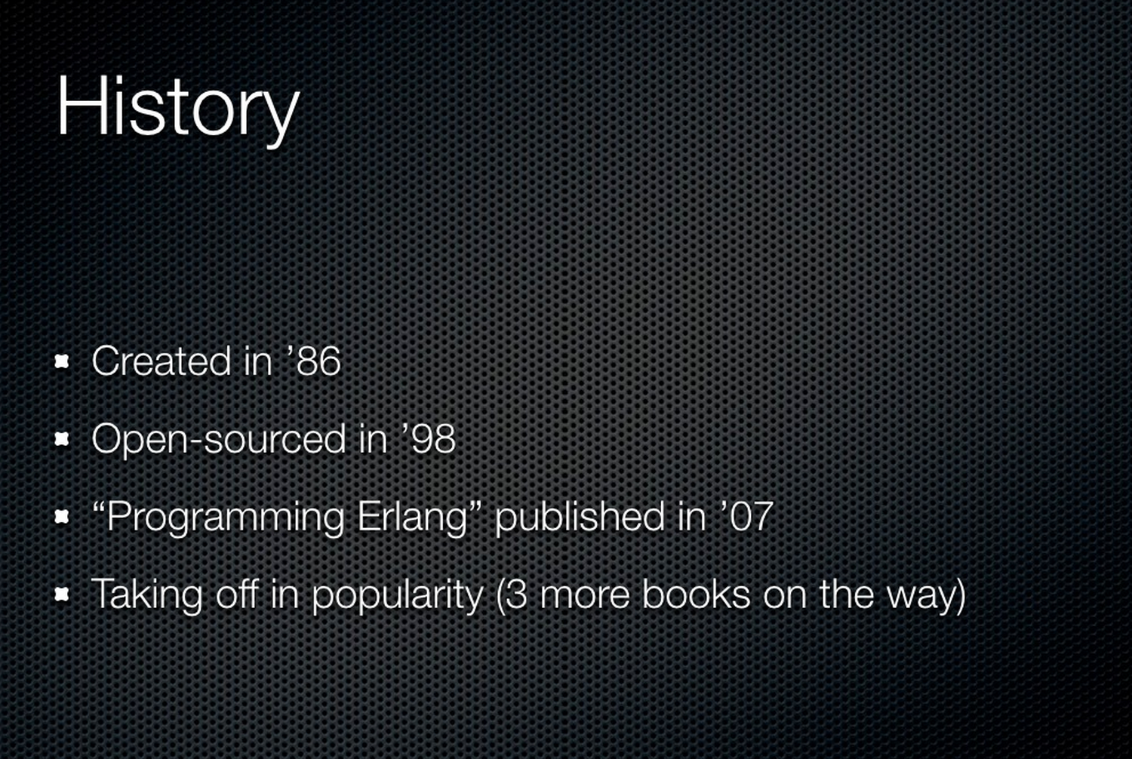

Slide 6
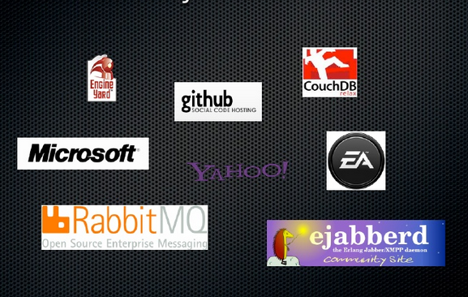

Slide 7
Erlang Philosophy
The world is concurrent
Things in the world dont share data
Things communicate with messages
Things fail
- Joe Armstrong

Slide 8
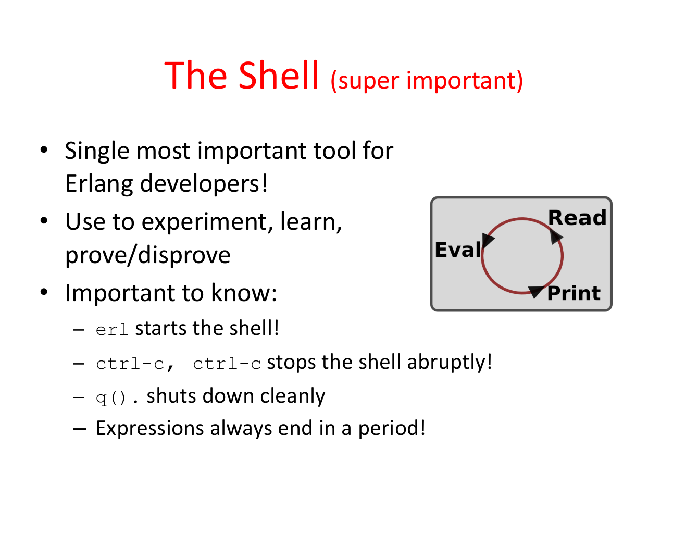

Slide 9
Language essentials

Slide 10
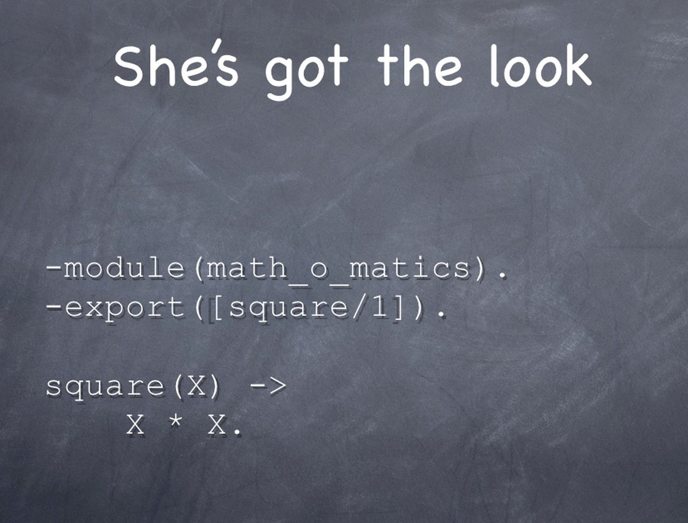

Slide 11
Data types
Integer / float
Atoms
Tuples
Lists
Binaries
… so where are strings?

Slide 12
Datatypes (cont)
Functions
Pids
Ports

Slide 13
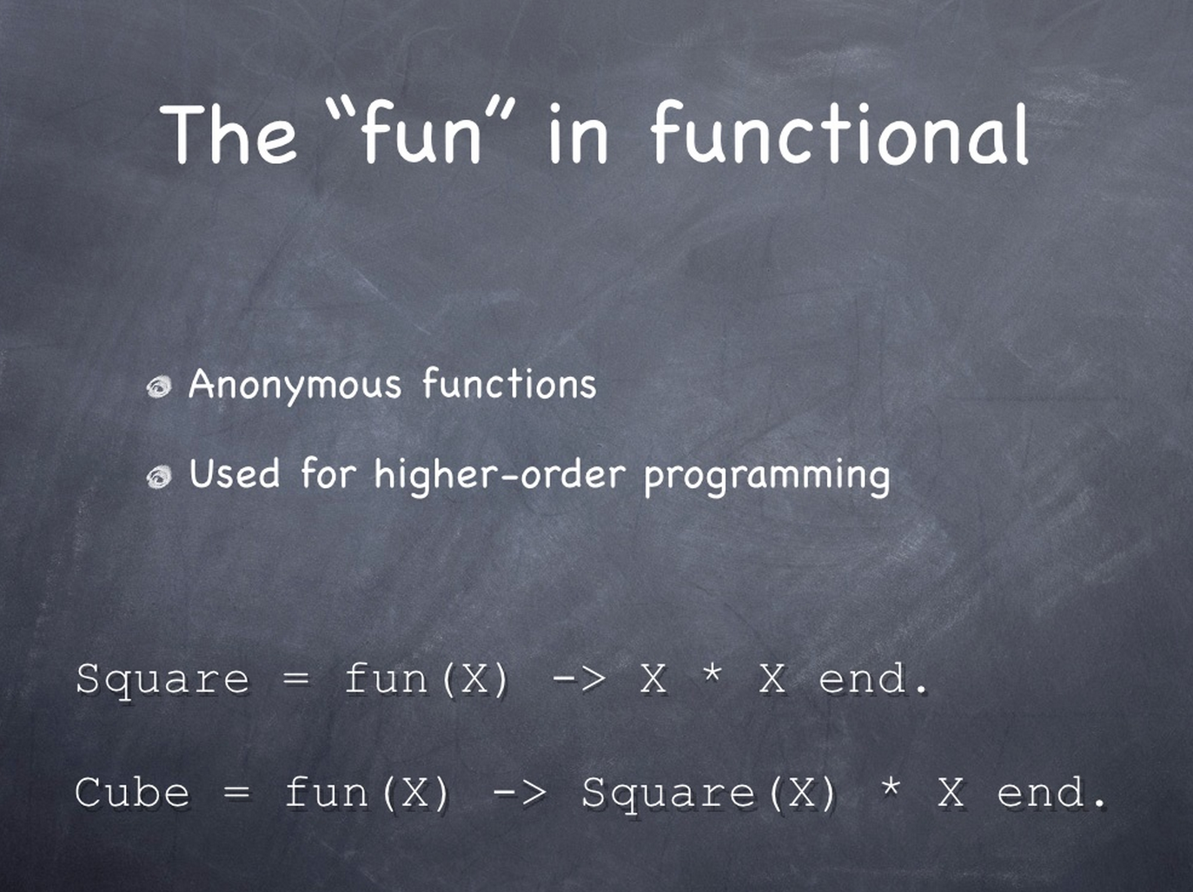

Slide 14
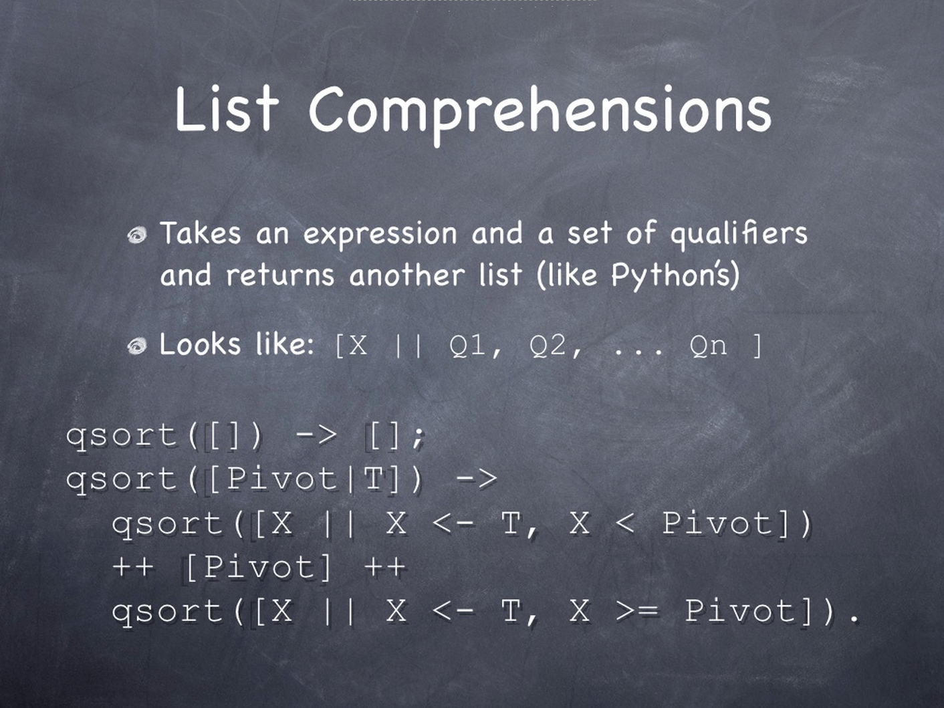

Slide 15
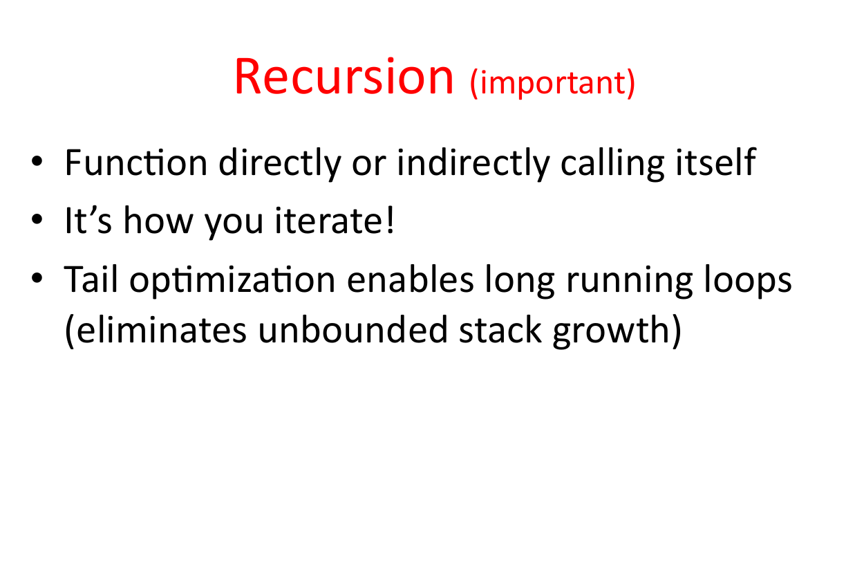

Slide 16
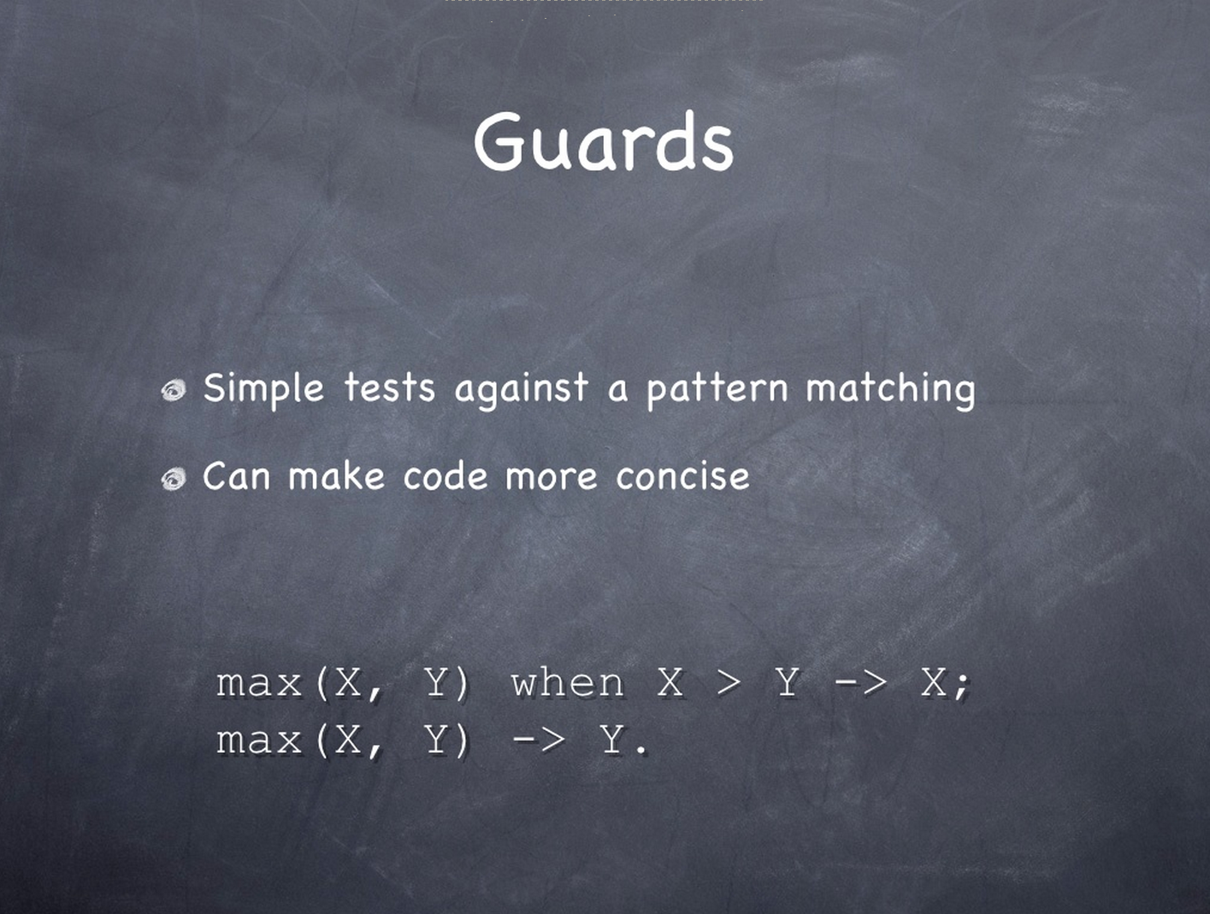

Slide 17


Slide 18
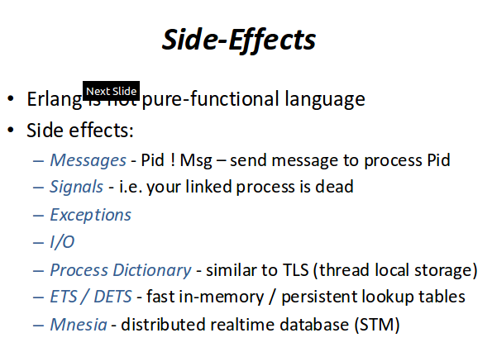

Slide 20
Concurrency / failure

Slide 21
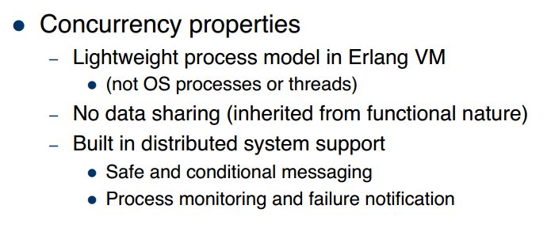
Concurrency
spawn, spawn_link
!, receive

Slide 22
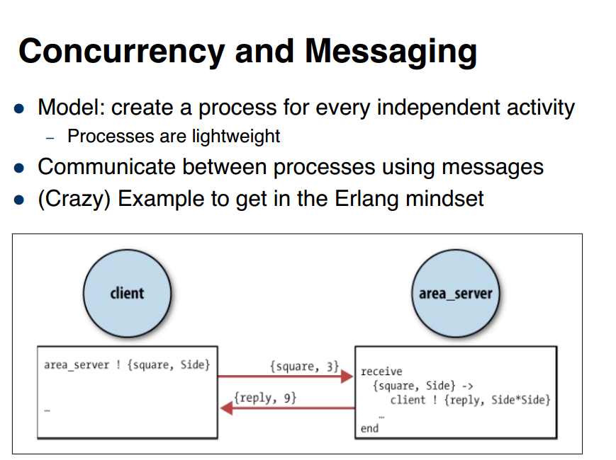

Slide 23
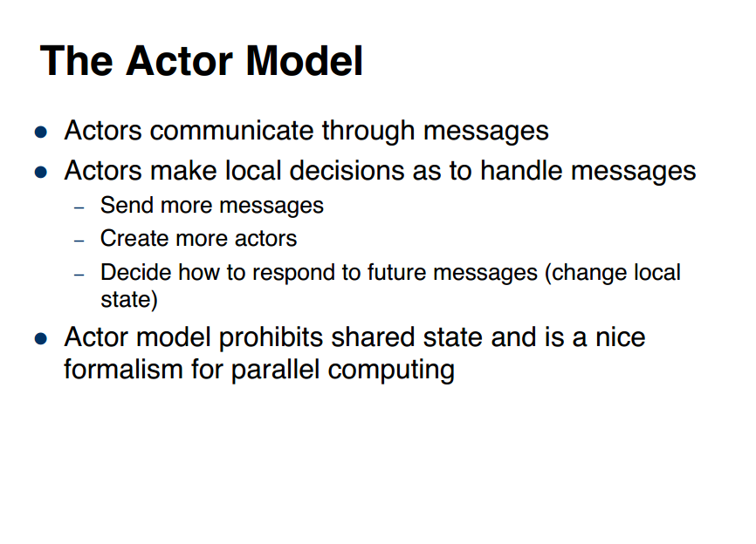

Slide 24
An example “worker pool” script
worker.erl
https://gist.github.com/arjan/4283899

Slide 25


Slide 26
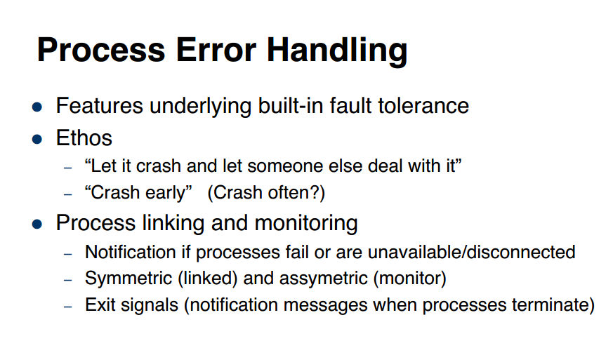

Slide 27
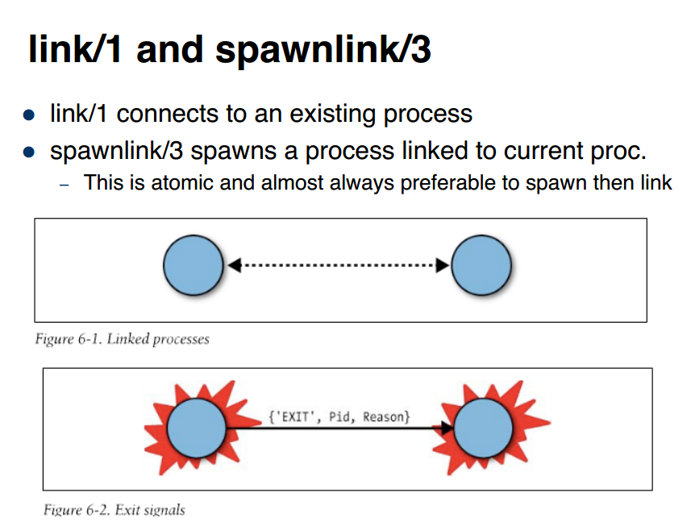

Slide 28
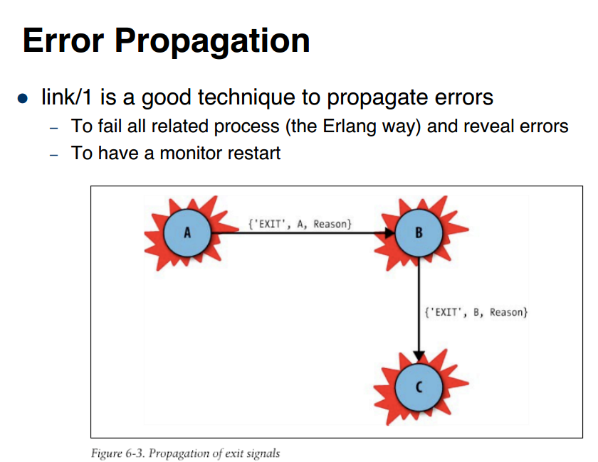

Slide 29
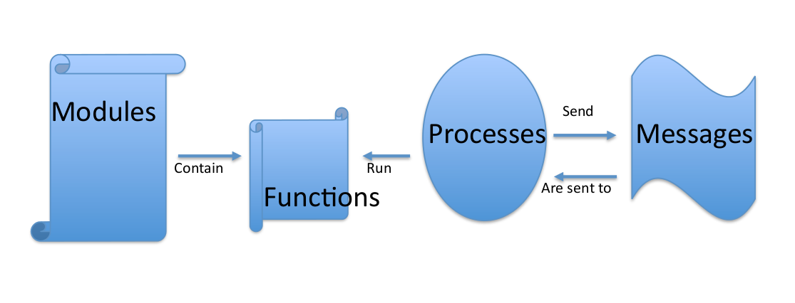
Fundamental pieces

Slide 30
OTP: Open Telecom Platform

Slide 31
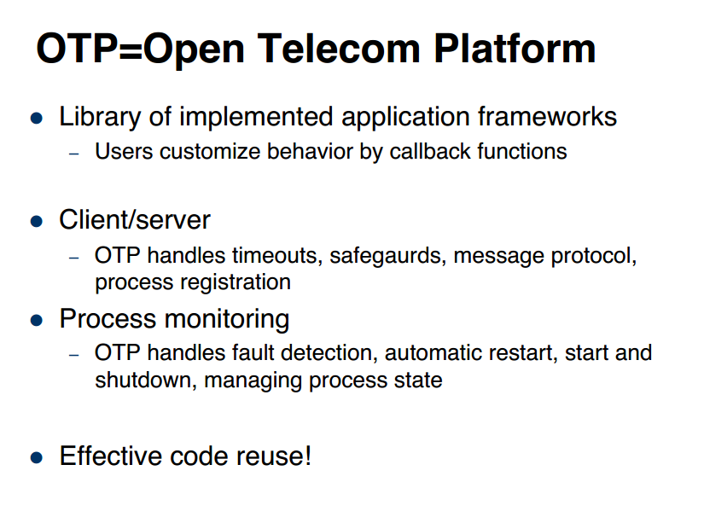

Slide 32
OTP
application
  Contains independent code, multiple applications per Erlang node
supervisor
  Supervises worker processes and supervisors
gen_server
  Basic work unit

Slide 33
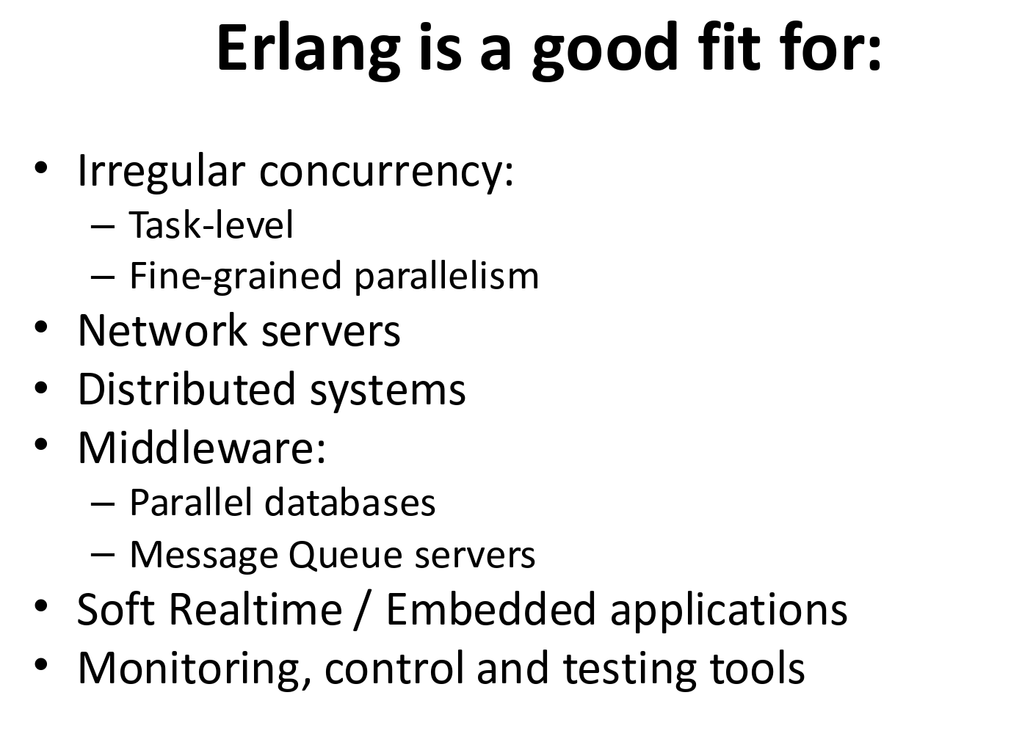

Slide 34
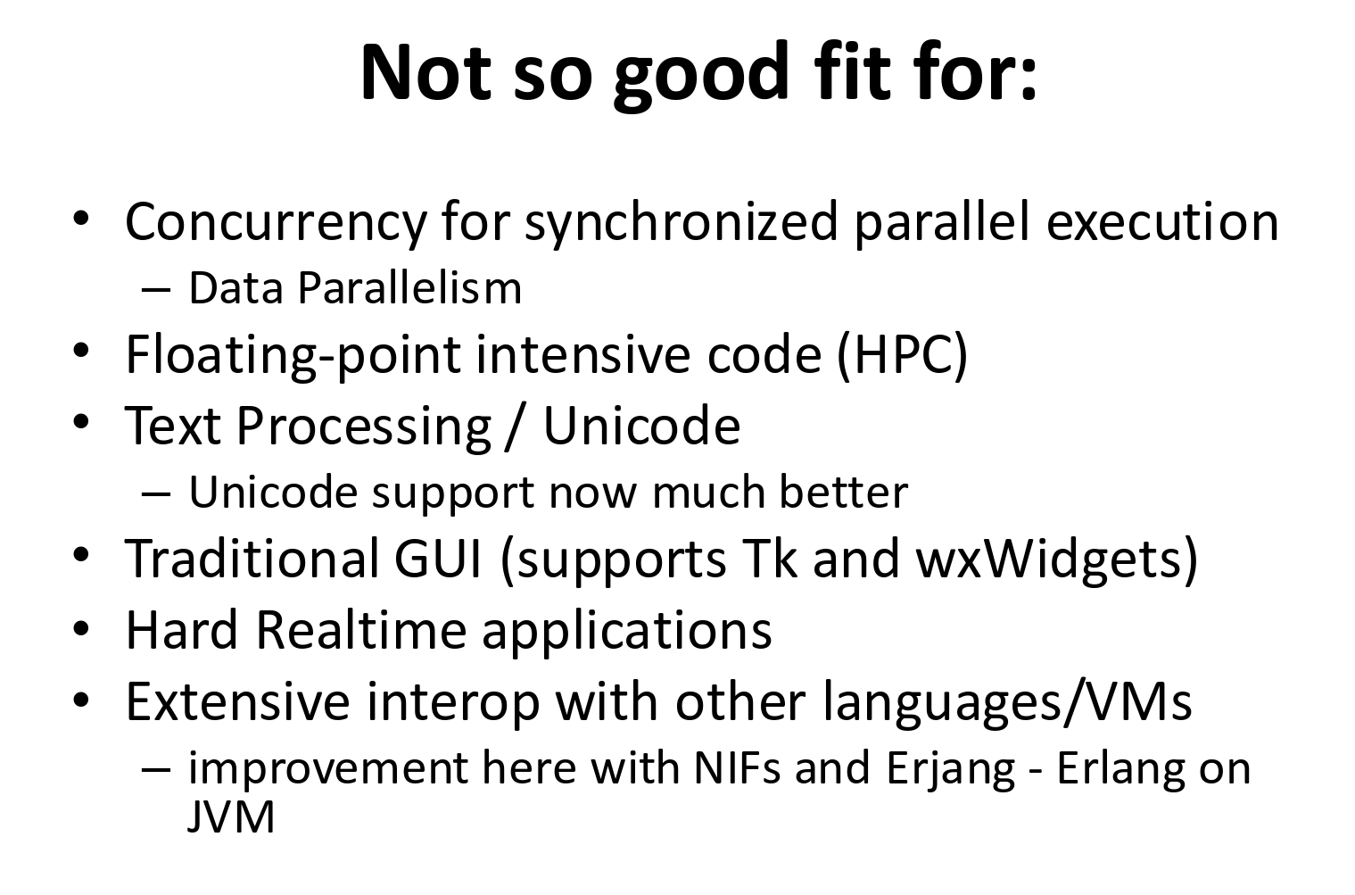

Slide 35
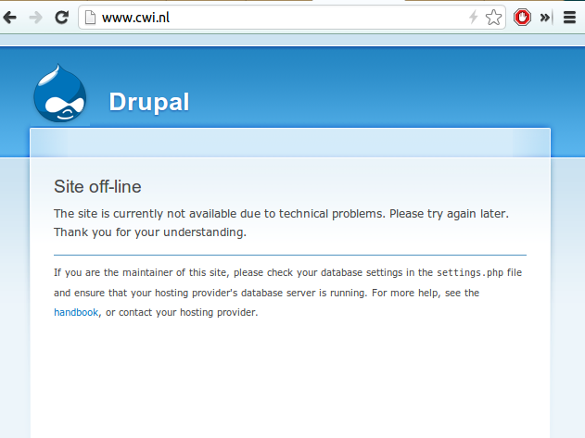
What I mainly use it for
Full-stack web development
  http://zotonic.com/
HA backend systems
Preventing stuff like this →
:-)

Slide 36
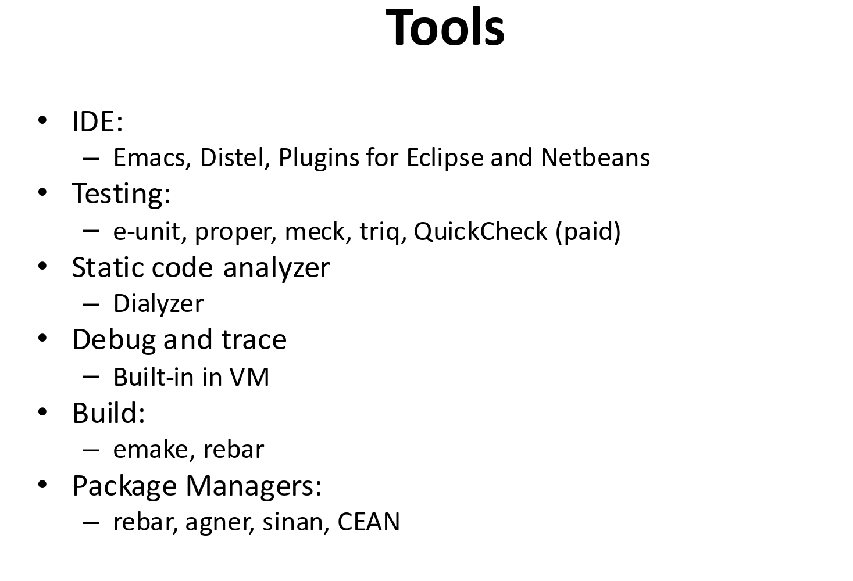

Slide 37
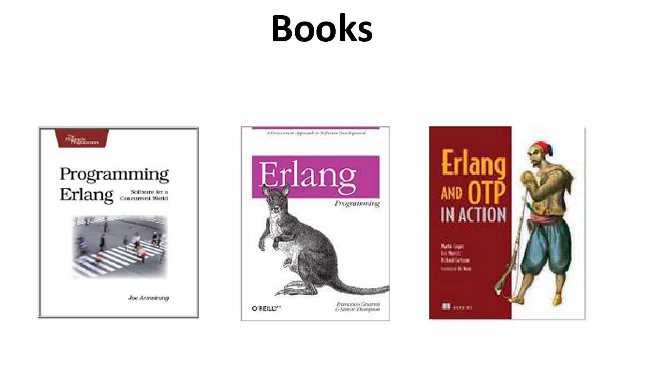

Slide 38
Sources of Inspiration
Erlang - the ghetto
Intro to erlang (slideshare)
Erlang - message passing concurrency (slideshare)
Erlang concepts (slideshare)
Concurrency and Paralellism in Erlang (hopkins univ)

Slide 39
Getting practical

Slide 40
Assignment!
Building a simple chat system using Erlang's process model
Download the assignment PDF
Best submission wins a t-shirt!

Slide 41
Reclameblok!!
Try Zotonic – the Erlang Web Framework and CMS
Erlang Camp Amsterdam
  30 & 31 augustus
  Slechts 75 euro!

Slide 42
Thanks!
Arjan Scherpenisse
arjan@miraclethings.nl
http://twitter.com/acscherp
http://miraclethings.nl/

